Slide 1
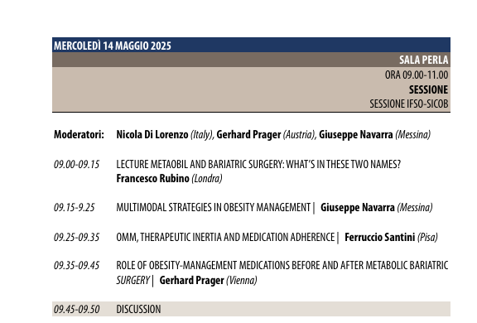






AZIENDA OSPEDALIERO - UNIVERSITARIA PISANA
U.O. ENDOCRINOLOGIA 1
Direttore Prof. Ferruccio Santini
Sezione Centro Obesità e Lipodistrofie

Slide 2
Therapeutic inertia is often defined as a failure to initiate or intensify treatment when indicated by clinical guidelines, resulting in limited or delayed initiation of more effective strategies. This delay in treatment intensification has been associated with short‐ and long‐term consequences such as increased risk of T2D, non‐alcoholic steatohepatitis, heart failure, and reduced life expectancy.
Law et al. Clin. Obes. 2024

Slide 3
Obesity Management Medication: Therapeutic inertia exhibited from patients with obesity
Limited awareness of the disease and its effects on personal well-being.
The expectation of identifying external causes of obesity that could be addressed through simple interventions.
Inadequate comprehension of the therapeutic efficacy of medications.

Slide 4
Obesity Management Medication: Therapeutic inertia exhibited from healthcare providers
Limited understanding of the disease and its impact on individual health.
Insufficient knowledge regarding medication usage and an excessive concern about potential side effects.
The requirement for detailed explanations about medication use, along with counseling on diet and lifestyle, leading to a time-consuming process.

Slide 5
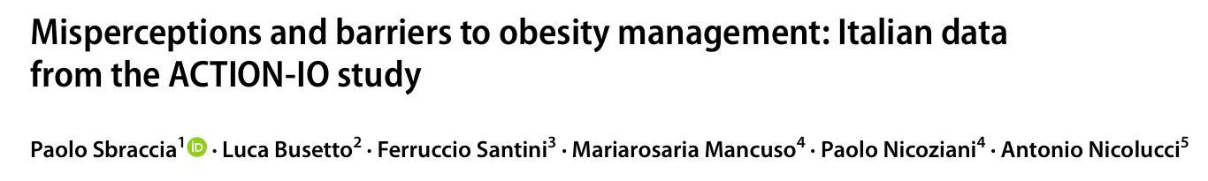
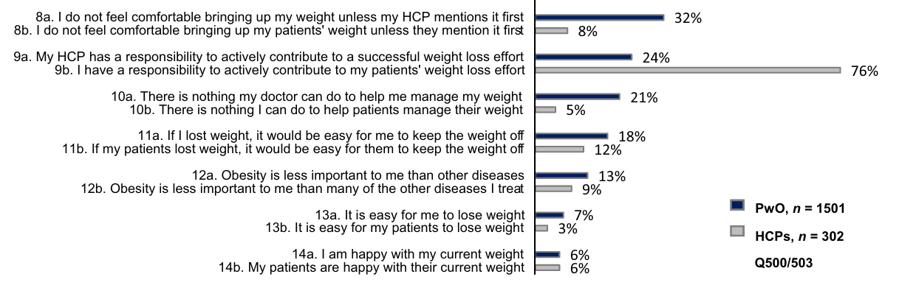

Slide 6
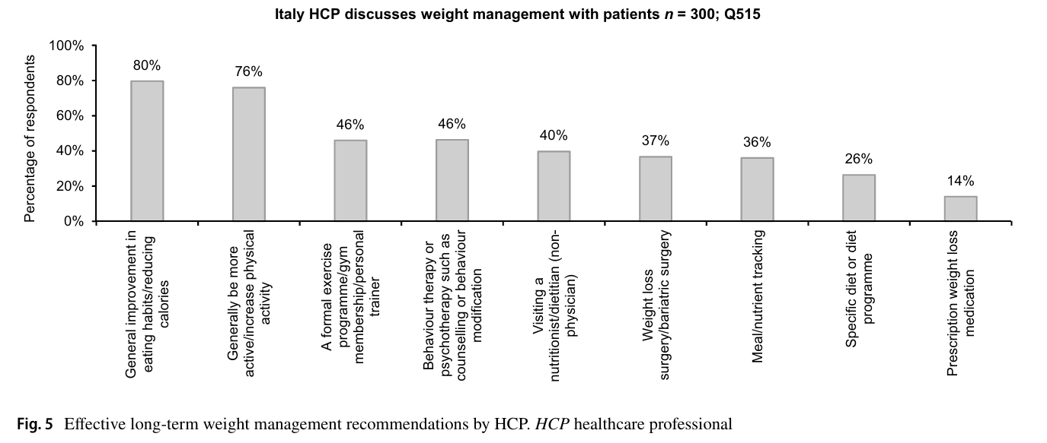

Slide 7
Obesity Management Medication: Medication adherence
Factors contributing to poor adherence:
Lack of therapeutic efficacy
Adverse side effects
Unrealistic expectations
Financial constraints

Slide 8
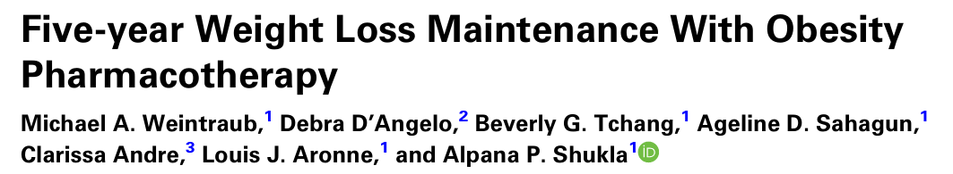
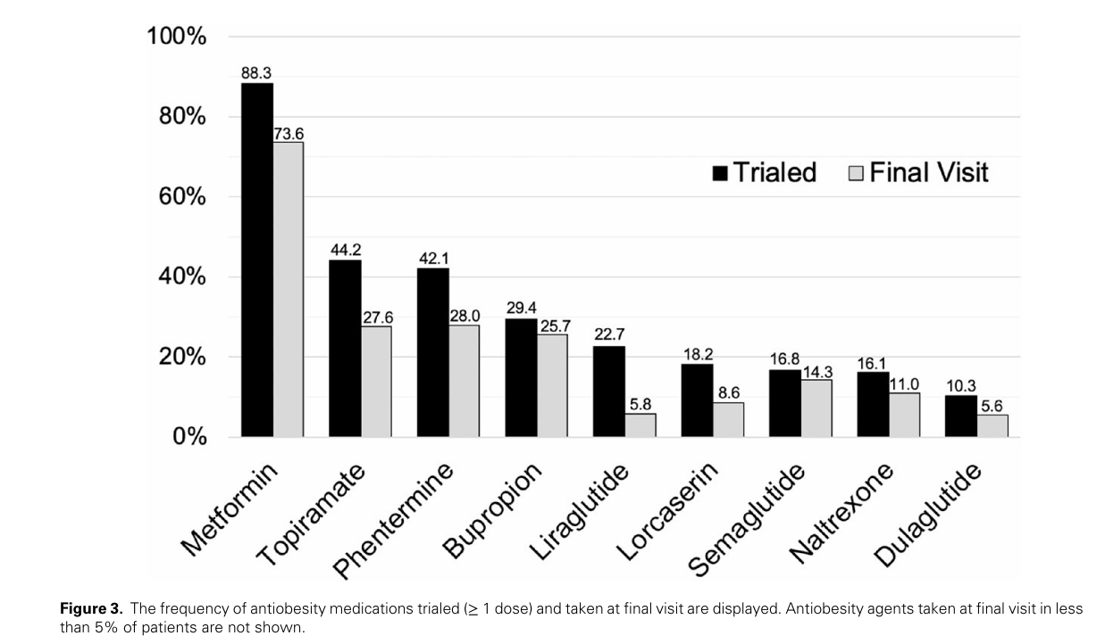

Slide 9
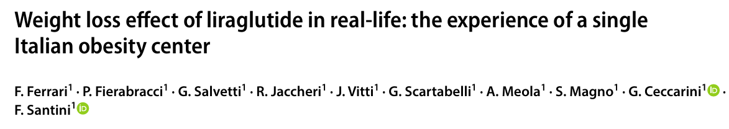
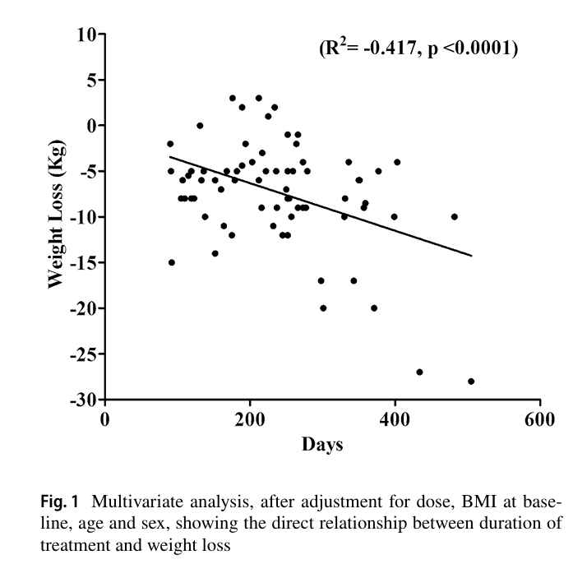

Slide 10
21/93 (23 %) patients discontinued the treatment within 90 days owing to various reasons:
6 for economical concerns,
6 for poor efficacy (weight loss < 2%),
5 for gastrointestinal side effects,
1 for injection-site irritation and discomfort,
1 for both diarrhea and injection-site irritation,
1 for tachycardia, and 1 for anxiety.

Slide 11
Adherence to liraglutide treatment in real life
Wharton 2019 (Canada): 144/311 (46 %) discontinued the treatment within 9 months (no reasons)
Luindegaard Haase 2021 (Switzerland) : 206/277 (74%) discontinued the treatment within 12 months (no reasons).
Calderon et al. 2021 (USA): 4/80 (5%) discontinued the treatment within 24 months for side effects.
Alarfaj et al. 2022 (Saudi Arabia): 55/105 (53%) discontinued the treatment within 1 month for side effects (7 patients) other reasons (3 patients ), no data (45 patients)
Wilmington et al. 2023 (United Kingdom): 15/50 (30%) discontinued the treatment within 52 weeks for being listed for bariatric surgery (12 patients), compliance issues (2 patients) or side effects (1 patient).
Leventhal-Perek et al. 2023 (Israel): 733/1497 (49%) discontinued the treatment within 6 months.
Alshehri et al. 2023 (Saudi Arabia): 0/399 (0%) discontinued the treatment within 6 months.
Santini et al. 2023 (Switzerland) : 5/54 (9 %) discontinued the treatment within 10 months 1 for pregnancy (at 3 months) and 4 after failing to meet the weight-loss percentage at 4 months for insurance reimbursement.
Goëau-Brissonnière et al. 2024 (France): 48/67 (72 %) discontinued the treatment within 9 months for cost (16 patients), side effects 15 patients, loss of efficacy 12 patients, physician’s decision 7 patients, constraint of subcutaneous injections 4 patients.

Slide 12
THE FUTURE ?
100 %
NOW
Adherence
Efficacy / cost

Slide 13
CONCLUSIONS
Therapeutic inertia in obesity management medication continues to be a significant issue, stemming from factors related to both patients and healthcare providers.
Therapeutic adherence in real-life settings is still limited by various factors, with side effects being only one partial contributor.

Slide 14
Thank you!

